Slide 1
Host-Based InTRUSION DETECTION SYSTEM
Slide Presentation by Andrew Dykman. Homework #6
Acronym Used by People in the Field: H.I.D.S.

Slide 2



What it is:
Consists of an agent program on a host that identifies intrusions by analyzing system calls, application logs, file-system modifications and other host activities.
In case of an attack, the H.I.D.S. will notify personnel at a monitoring / security terminal. More advanced H.I.D.S systems will check a profiled event when it is detected, and pass it to a correlation engine that determines whether vulnerability is being exploited first, such as in the case with HP-UX 11i Security H.I.D.S.

Slide 3

HIDS monitors for the exploitation of the following vulnerabilities to detect attacks or misuse:
Poorly written privileged programs
Unauthorized File Modification:
Critical system and application programs
Configuration files System and application log files
File additions and deletions
Critical files made world writable
Privileged 'setuid' programs created
Files modified by non-owners
Monitors logins/logouts, weak password or unauthorized access
Password guessing: Failed logins and failed switch-user attempts

Slide 4

How it is used.
Ideally a HIDS works in conjunction with a NIDS, such that a HIDS finds anything that slips past the NIDS. Commercially available software solutions often do correlate the findings from NIDS and HIDS in order to find out about whether a network intruder has been successful or not at the targeted host.

Slide 5
Hackers do what?
The principle operation of a HIDS depends on the fact that successful intruders (hackers) will generally leave a trace of their activities. In fact, such intruders often want to own the computer they have attacked, and will establish their "ownership" by installing software that will grant the intruders future access to carry out whatever activity (keystroke logging, identity theft, spamming, botnet activity, spyware-usage etc.) they envisage. Most successful intruders, on entering a target machine, immediately apply best-practice security techniques to secure the system which they have infiltrated, leaving only their own backdoor open, so that other intruders can not take over their computers.

Slide 6

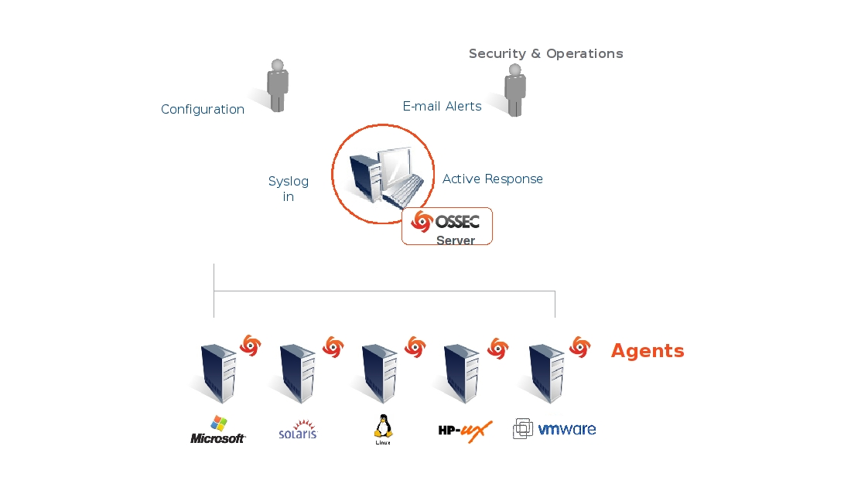
Some application-based I.D.S. are also part of the H.I.D.S. category
Tripwire
OSSEC (An Open-Source H.I.D.S.)

